Slide 1
Where are we in the fight against AMR
and what is our charity doing to tackle this major
health issue?
Professor Colin Garner, Chief Executive

Slide 2
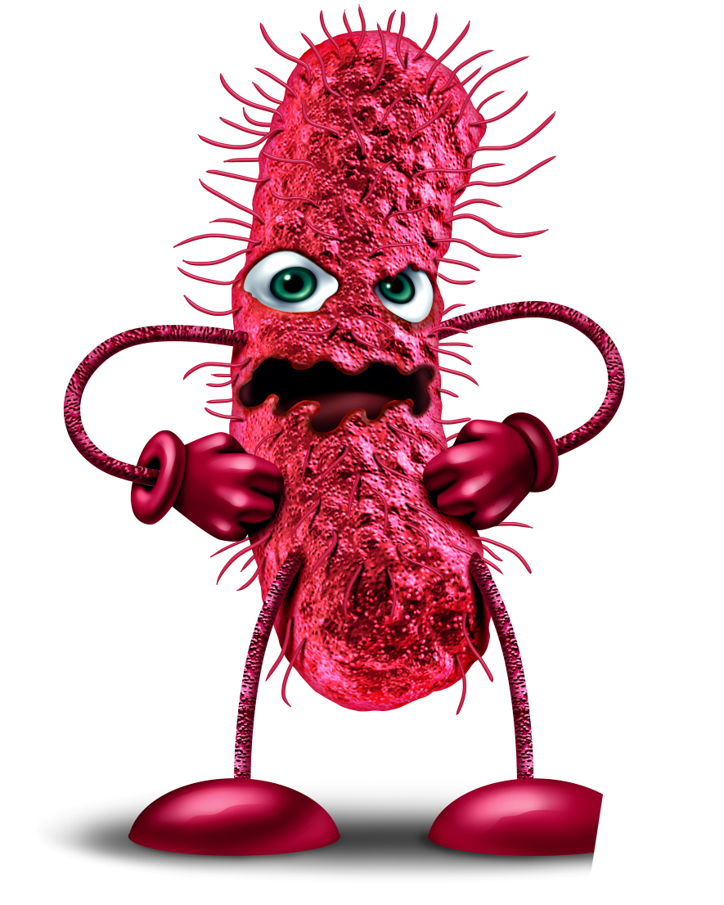
Antibiotic Resistance is already here
In Europe 33,000 deaths per year linked to antibiotic resistant infections.¹
In the UK this is at least 5000-6000 deaths per year, and could be as high as 12,000.²
© 2019 Antibiotic Research UK
Notes:
Antibiotic resistance is already here, if you know someone who has had a course of antibiotics and is still unwell and is therefore given more, that is antibiotic resistance
Antibiotic Resistance is a major public health problem. It is currently linked to 33,000 deaths in Europe and between 5-6 thousand deaths in the UK according to official reports but it is suggested that this is under-reported and could be nearer 12,000 .
The reason it would be underreported is that it often isn’t listed on death certificates. If someone has cancer and dies of an infection which was antibiotic resistant it will be listed as cancer.

Slide 3
Its in the media….
Notes:
We often see sensationalist headlines like the ones above which almost appear to lay the blame at the doors of the hospital whereas in reality this is such a hard problem for them to tackle that has been on the cards since antibiotics was discovered and they need help to deal with it.
Manchester CPE: https://bit.ly/2FyVSTB The Guardian April 2017
~ Manchester KPC: https://ind.pn/2TsoEsZ The independent March 2014
~ Worcester KPC: https://bbc.in/2HY3p07 BBC News November 2018
~ London CPE: https://bit.ly/2OowjHL Imperial College news November 2016
~ Leicester CRO/CPE: https://bit.ly/2Op5nYm Leicestershire Live September 2018

Slide 4
The time bomb is ticking….
By 2050, deaths linked to antibiotic resistance could be as many as 10 million per year.
© 2019 Antibiotic Research UK
Notes:
But the reality is that if something isn’t done it is estimated that by 2050, 10 million people globally could die each year from the impact of Antibiotic Resistance.

Slide 5
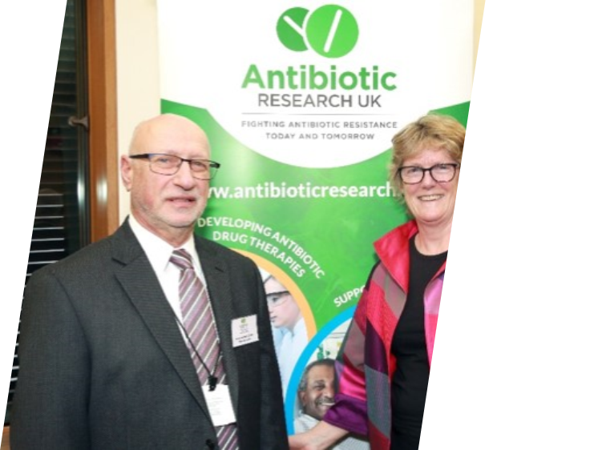
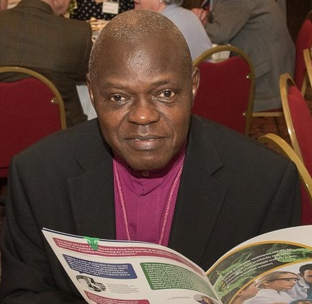
Background to ANTRUK
Who we are:
Founded in 2014 by CEO Colin Garner along with other expert AMR scientists and clinicians
The first and only charity in the world set up to tackle bacterial antibiotic resistance
A young, virtual charity - we punch above our weight
Supported by experts on our Science and Education Committees
Mission:
To enable and support the discovery and development of antibiotics for use against antibiotic-resistant bacteria
To educate the public about the dangers of antibiotic resistance and how to prevent it, and
To provide patient support and information.
Notes:
So now we have set the record straight about antibiotic resistance, let’s learn more about the ANTRUK, the world’s first and only charity set up to tackle antibiotic resistance
Who we are
Antibiotic Research UK (ANTRUK) was founded in 2014 to tackle antibiotic resistance. It’s roots started in York where our founder and CEO Colin Garner lives and we are proud to have the Archbishop of York as our patron. Colin is a university academic scientist and a scientific entrepreneur. He headed up a cancer research lab for almost 20 years. He founded 3 university spinout companies before starting ANTRUK in 2014.
We are a ‘virtual’ charity, which means we don’t have a central office. This allows us to spend more of your donations on research into new antibiotics, rather than paying overheads, and allows world-class experts to be an integral part of our work, wherever they are based.
ANTRUK’s Vision: 1) To enable and support the discovery and development of antibiotics for use against antibiotic-resistant bacteria 2) to educate the public and professionals about the dangers of antibiotic resistance and how to prevent it, and 3) to provide patient support and information.

Slide 6
Fighting Antibiotic Resistance Today and Tomorrow….what does it mean?
ANTRUK’s mission:
We aim to bring at least one new antibiotic treatment to the market by the early 2020s
We fund research in the best universities and in the UK, overseen by the antibiotic resistance experts on our Science Committee
We provide education for the public, including supporting the national campaign “keep antibiotics working” launched by Public Health England all overseen by our Education Committee
We provide support and information for patients through our Patient Support Officer

Slide 7
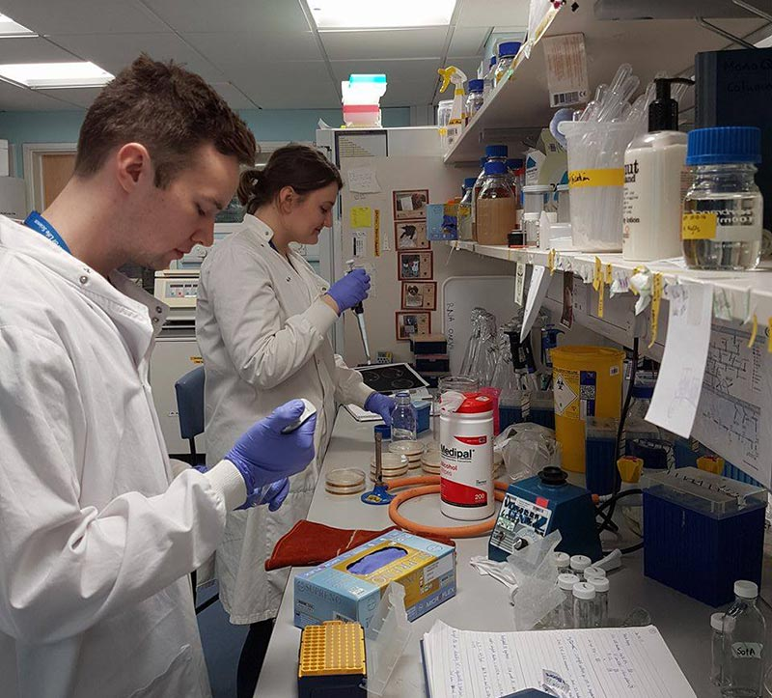
ANTRUK Successes to Date 1.Research
Breaking Antibiotic Resistance
Non- Antibiotic Alternatives
Small Research Grants Scheme
1.Antibiotic
Resistance
2.New Antibiotic
therapies
3. Health and
societal
impact
Test Sensitivity Discs
In depth testing
Non antibiotic alternatives
to treat “Travellers’
Diarrhoea”
Notes:
Our current research programme falls into 3 key areas:
Breaking antibiotic resistance – from initial screening work into use of combinations of antibiotics and other drugs to break resistance 2 further exciting research projects have emerged:
Test Disc Sensitivity Kits – Sensitivity discs are used in hospital laboratories to test whether a specific bacteria causing an infection is sensitive to i.e can be killed by a specific antibiotic (s). ANTRUK has supported the development of discs which include a combination of an antibiotic and a resistance breaker against commonly resistant bacteria. Through partnerships identified by ANTRUK it is hoped to make these kits widely available to hospitals throughout the UK, enabling a targeted approach to treating infections caused by these bacteria.
Further in depth testing – a number of new combinations were identified from the initial phase of the project which could be used to develop new combination therapies, including some novel mechanisms which we are excited to investigate further.
Non- Antibiotic Alternatives – the first ANTRUK research programme in this area is exploring a possible alternative to treat travellers’ diarrhoea which is estimated to affect up to 40% of travellers and a common cause of death for people living in less developed countries. This research project is a partnership between ANTRUK and 2 universities (Southampton and one in China). A trial has been set up to test 3 different components all of which are not antibiotics and are widely available over the counter. Patients recruitment into this trial started in January 2019.
Small Research Grants Scheme – This initiative was launched in 2018 to breathe life into antibiotic research projects across the UK by providing small grants to fund mostly early research, primarily in University research groups. The scheme focuses on:
Research into antibiotic resistance
New antibiotic therapies
Health and societal impact of antibiotic resistance and how it could be avoided.
We are urgently seeking to fundraise to continue to support these important projects.

Slide 8
ANTRUK Successes to Date
Breaking Antibiotic Resistance
Non- Antibiotic Alternatives
Small Research Grants Scheme
Research
1.Antibiotic
Resistance
2.New Antibiotic
therapies
3. Health and
societal
impact
Test Sensitivity Discs
In depth testing
Non antibiotic alternatives
to treat “Travellers’
Diarrhoea”

Slide 9
ANTRUK Successes to Date
Breaking Antibiotic Resistance
Non- Antibiotic Alternatives
Small Research Grants Scheme
Research
1.Antibiotic
Resistance
2.New Antibiotic
therapies
3. Health and
societal
impact
Test Sensitivity Discs
In depth testing
Non antibiotic alternatives
to treat “Travellers’
Diarrhoea”

Slide 10
ANTRUK Successes to Date
Breaking Antibiotic Resistance
Non- Antibiotic Alternatives
Small Research Grants Scheme
Research
1.Antibiotic
Resistance
2.New Antibiotic
therapies
3. Health and
societal
impact
Test Sensitivity Discs
In depth testing
Non antibiotic alternatives
to treat “Travellers’
Diarrhoea”

Slide 11
2019 Small Research Grant recipients
Name | Organisation | Title
Dr Ishwar Singh | University of Lincoln | Evaluation of bacterial tolerance to synthetic teixobactins
Mr Christopher Beaudoin | University of Cambridge | Inhibition of the Mycobacterium tuberculosis RecA protein
Professor Jamie Davies | University of Edinburgh | AntibioticDb database, and BPS/IUPHAR Guide to PHARMACOLOGY database, working together to create a powerful data resource for antibiotic pharmacology
Dr Julia Hubbard | University of Newcastle | Enabling structure based drug discovery on the outer membrane protein LptDE

Slide 12
Patient Support Pilot
A clear unmet need for patients and carers
Patient Support Officer recruited who will:
Provide a single point of contact for patients reaching out to ANTRUK
Identify patient information needs
Develop information to meet unmet needs
Design and create a web based “One Stop Shop” for information
Develop a patient network for support
Notes:
We recognise that patients and their families and carers need to know where they can find information about antibiotic resistance and support to help them through antibiotic resistant infections and that currently this is an unmet need. We therefore recruited a Patient Support Officer to develop and drive a programme that meets the needs of patients and their carers. This is currently a one year pilot until we can raise the funds to support the programme permanently
The Patient Support Officer will:
Provide a single point of contact for patients reaching out to ANTRUK
Identify patient information needs
Develop information to meet unmet needs
Design and create a web based “One Stop Shop” for information
Develop a patient network for support

Slide 13
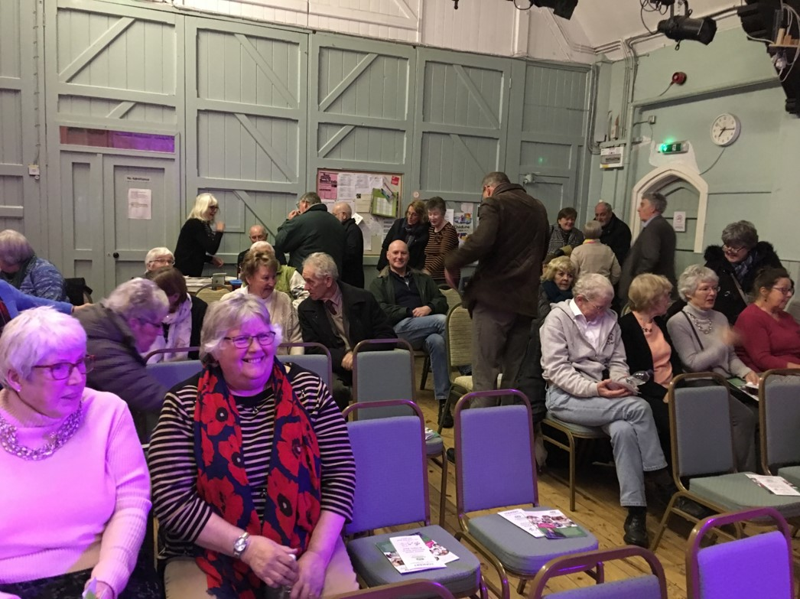
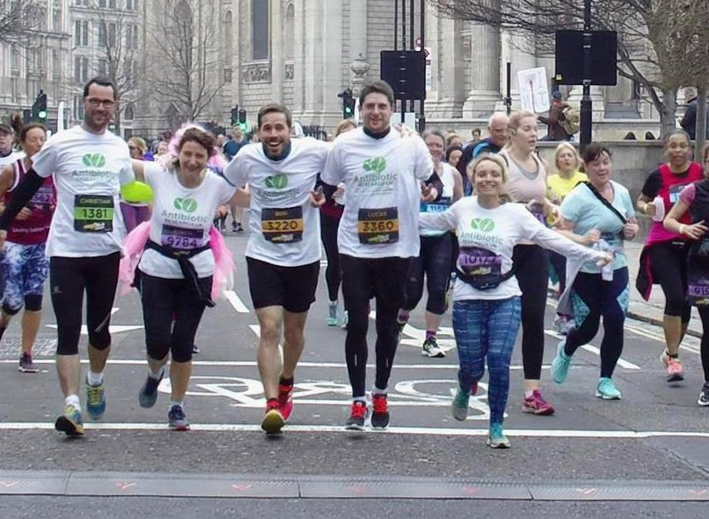
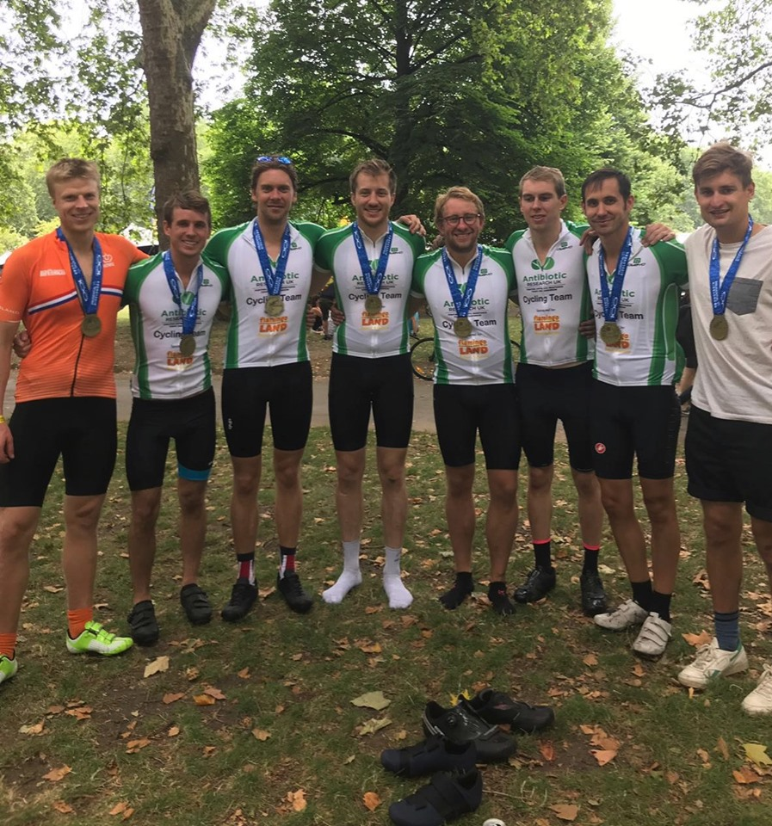
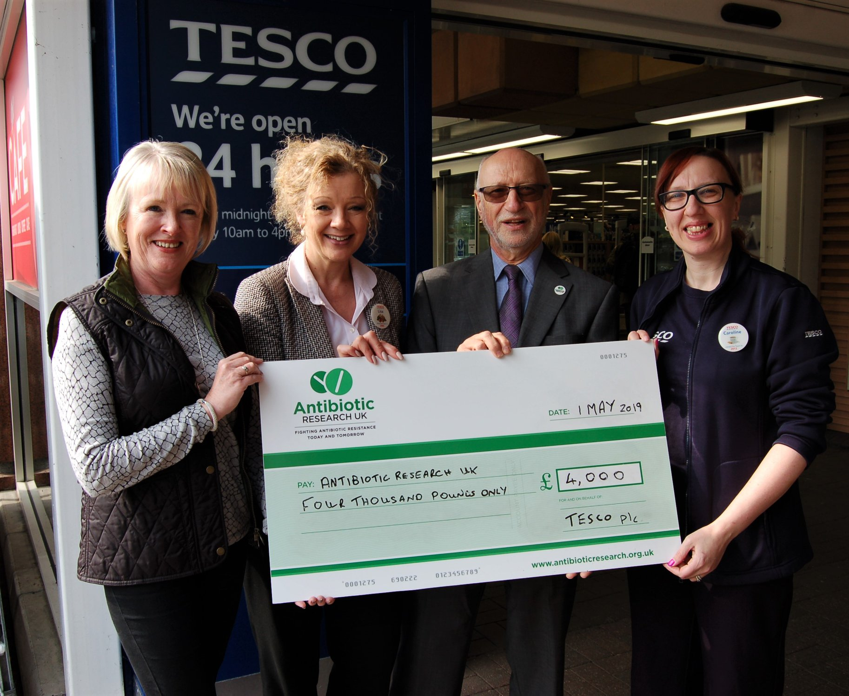
Fundraising
All ANTRUK’s income is generated by fundraising – we receive no government funding
Supported by small dedicated team of fundraisers
Networks of volunteers help to raise funds and spread the word about antibiotic resistance
Notes:
We have raised over £1million so far and we are seeking to raise another £5million by 2021

Slide 14
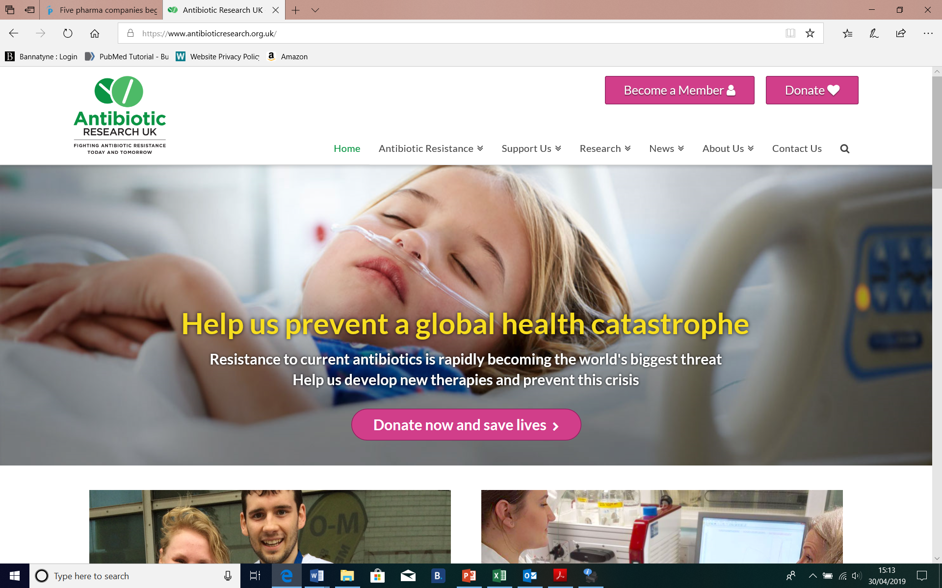
How you can help to save lives
GIVE US A DONATION
Fundraise
Take part in a sponsored sporting event
Leave a gift in your will
Volunteer
Become a Member https://www.antibioticresearch.org.uk
Spread the word
Text FIGHT10 or ANTI10 to 70085
Notes:
Donate on website, texting to donate £10 or I have some forms with me
Fundraise – we ask people to hold tea parties in November to celebrate World Antibiotics Awareness Week or hold your own event at any time
Sporting event – we have places in Ride London and London Landmarks Half Marathon next year, or you could hold your own event.
Give a gift in your will – leaving a gift in your will could help future generations with this global health threat, there are also tax breaks when doing this.
Volunteer – looking to set up volunteer fundraising groups, people to give speeches like I have today or one off support for collections and events (cheer stations)
Become a member – this means you can attend the AGM and vote for the appointment of trustees and officers
Spread the word – we need people to use antibiotics responsibly, and we need people to know we are here and what we are doing. Follow us on social media, share our stories, tell people about us (especially if your neighbour wins the Euromillions this week!!)

Slide 15
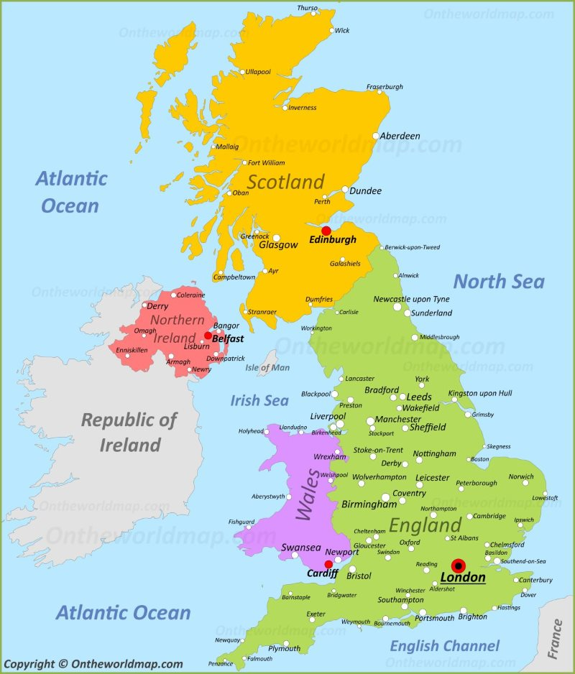
We are a virtual charity covering the whole United Kingdom

Slide 16
Why not organise a Great British Tea Party?

Slide 17
GO TO
www.antibioticresearch.org.uk
and learn more about us – join the resistance
against resistance
AntibioticResearchUK
@1ANTRUK

