Slide 1
Azithromycin resistance in protracted bacterial bronchitis
Dr Simon Hardman
Bassetlaw clinical research fellow & pediatric registrar
Supervisors: Professor A. Condliffe (IICD) & Dr A. Lee (ScHARR)
Notes:
Peads reg and clinical fellow. My time is spent 50 50 between clinical oncall and research. Unser supervision from …

Slide 2
Antibiotic resistance
Antibiotic prophylaxis
Risks
Antibiotic resistance
Changes to microbiome
Benefits
Prevention of infections and end organ damage
May reduce overall antibiotic exposure
May limit pathogen spread
https://www.gov.uk/government/publications/health-matters-antimicrobial-resistance/health-matters-antimicrobial-resistance
Notes:
The driving factor for my research is the serious threat of antibiotic resistance. Health care professionals have a duty to practice good antimicrobial stewardship to help address this issue.
Prophylaix is the prescribing of low dose regular antibiotics of varying duration. Potential risk of promoting antibiotic resistance which is not only a problem for the individual but also for the wider community. These antibiotics may also affect other beneficial flora throughout the body known as the microbiome.
For the individual though there may be substantial benefits of preventing infections and end organ damage… reducing the number of courses of rescue antibiotics and potentially reducing the spread of respiratory pathogens by reducing coughing.
Sheffiedl Azithromycin second most proscribed antibotcis ofr prophylaxis after cotrimoxazole. Audit 2018 June

Slide 3
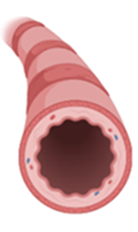
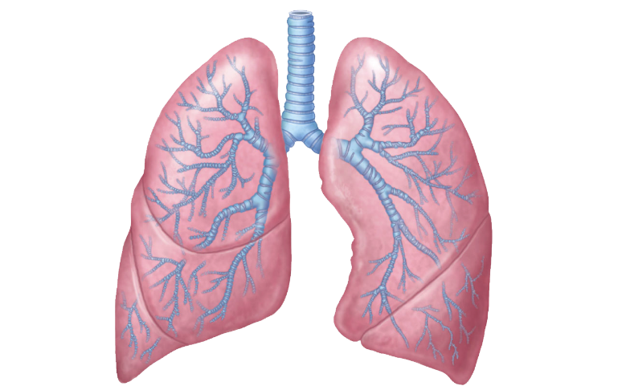
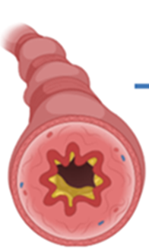
Protracted bacterial bronchitis (PBB)
Chronic wet cough:
10-15% of children
Up to 40% are due to PBB
Absence of other causes
Inflammation and infection of airways
Response to 2-4 weeks of antibiotics
? Bronchiectasis
Lifelong infections & acquisition of AMR
Azithromycin prophylaxis
Healthy bronchiole
PBB bronchiole
↑ Inflammation
Neutrophilia
IL-1β, IL-8, IL-1 pathway cytokines
↑ respiratory bacterial pathogens
H. influenzae
S. pneumoniae
M. catarrhalis
Reference: A. Kantar et al. ERS statement on protracted bacterial bronchitis in children
European Respiratory Journal Aug 2017, 50 (2)
Notes:
Chronic wet cough is really common, affecting up to 15% of preschool children
Of these up to 40% are due to PBB. So what is PBB? It is an inflammatory condition of the breathing tubes (bronchi) usually due to infections with common respiratoty pathogens but in some children it seems to linger. It does respond to lenghty courses of antibiotics but tends to recur. Up to (up to 75% of affected children have multiple epsiodes).
In addition to the ill-health this causes at the time, > 3 episodes of PBB a year has been reported to lead to bronchiectasis – irreversible airway damage. Bronchiectasis is associated with lifelong recurrent infections, chronic airway colonisation with respiratoyr pathogens, heavy antibiotic use and acquisition of AMR organisms such as Pseudomonas aerugoniam. It leads to premature death .
Azithromcyin prophylaxis (ie treating patients when they are well to prevent infection) is used to try and avert this serious condition. This may be seasonal over the winter months or more longer term over a year or so.

Slide 4
Study hypothesis and aims
Hypothesis
Children with PBB exposed to prophylactic azithromycin will develop macrolide resistant airway flora
Aims
Undertake a pilot study to assess feasibility of sample collection
Assess the resistance patterns in the nasal flora of children prescribed prophylactic azithromycin for PBB
Conduct parental interviews to explore the parental experience of having a child who is prescribed long term prophylactic antibiotics
Notes:
My hypothesis is….
I will present the aims of my first 6 months during this presentation
Obtained ethical approval
Started the pilot study into…
Conducting interviews as a parallel study to look at experience of having a child on long term antibiotics. We hope to investigate parental decision making with regards to uptake and compliance.

Slide 5
Methods
Sheffield Children’s Hospital
Ethical approval obtained
Prospective, single centre, observational study
Recruitment
Children 2-10yrs
Diagnosis of PBB past 12 months
10 = Azithromycin prophylaxis
10 = No azithromycin (control)
Adherence to azithromycin
Self reported diary
Deep Nasopharyngeal swabs
3 monthly over 12 month period
Culture respiratory pathogens
Susceptibility testing – azithromycin
Phenomenological study (‘antibiotic appetite’)
Interview 15 parents in study
Semi structured – 45 minutes
Notes:
We have conducted a single centre, prospective observational study and recruited children between the ages of 2 and 10 years who have had at least 1 epsiodes of PBB over the previous 12 months. 10 have been recruited as they are about to start prophylactic azithromycin and 10 as controls who aren’t expected to need azithromycin. Interviewing 15 different parents whose children have been taking prophylactic azithromycin for at least 3 months to prevent respiratory exacerbations.

Slide 6
Recruitment
Demographics at Recruitment
 | Control | Azithromycin
Age (mean) | 3yr 9m (31m – 65m) | 5yr 1m (28m-120m)
Female | 4 | 6
Microbiological diagnosis | 5 | 6
Parent smoker | 2 | 2
Premature <37 | 1 = 31/40 | 1 = 27/40
Ventilated | 0 | 1
Antibiotics previous 12 months | Mean = 2 (0 – 4) (3= macrolide) | Mean = 1.8 (0 – 5) (5 = seasonal prophylaxis)
Received Information
N=70
Controls = 53
Azithromycin = 17
Controls recruited
N=10
Azithromycin recruited N=10
1 left study – No reason given
Notes:
Approached 70 families whose children have a diagnosis of PBB. 17 of these were just about to start azithromycin. Recruited 10 to each arm with 1 in the azithromycin group leaving after the first swab – no reason given.
Demographics were similar in both groups although the azithromycin group were slightly older. The reason for the child being ventilated was due to complications secondary to her prematurity. Mean number of acute antibiotic was similar although 5 of the children in the azithromycin group had had azithromycin prophylaxis the winter before.

Slide 7
Interim Results at 9 months
Legend
Resistant
Susceptible
No growth
Macrolide
Resistance and susceptibility based on minimum inhibitory concentration EUCAST breakpoints
Notes:
These are the preliminary data for he 1st 9 months of the study. This gives an overview before going to the next slide with the numerical data.
X-axis denotes each individual participant and the y-axis shows each of the first 3 swabs.
Grey shows swabs with no significant bacterial growth. Red – presence of azithromycin resistant batceria and green azithromycin susceptible bacteria. To determine resistance we have used standardised tables which show the amount of antibiotic required to kill bacteria. These are known as breakpoints and determined by the European community on antimicrobial susceptibility testing
The most striking feature is that there is higher levels of resistance in the control group than expected. Expected background resistance of S Pneumoniae to be 5-10% in the UK.
Blue = those previous exposed to a macrolide over the last 12 months – acute prescription or seasonal prophyalxis

Slide 8
Interim Results at 9 months
70 swabs taken
41 = growth of bacterial respiratory pathogen
Controls = 24 out of 36
Azithromycin = 17 out of 34
Swab complications
2 minor nose bleeds
4 poor quality swabs
2 Laboratory protocol errors
Bacterial isolates
Diary use:
4 out of 10 completed (3 doses missed)
100% adherence reported in all others
Mean duration of prophylaxis: 17 weeks (range 1-35)
Bacteria | Control = 34 isolates from 36 swabs | Azithromycin =25 isolates from 34 swabs
S. pneumoniae | 11 (32%) | 7 (28 %)
H. influenzae | 15 (44%) | 8 (32%)
M. catarrhalis | 5 (15%) | 8 (32%)
S. aureus | 3 (9%) | 2 (8%)
Notes:
We have taken 55 swabs so far and 60% of them have grown bacterial respiratory pathogens. There is a reduction in positive samples in the azithromycin group as has been found in previous studies.
Similar bacteria are present in both groups although there is a trend to less HI in the azithromycin group. This result has also been found in the AMAZES trial looking at the use of long term azithromycin in asthma. Can also see there are less positive bacterial isolates in the azithromycin group.
Minor complications included..

Slide 9
Phenomenological Study - Interim Results
Decision making
Desire for child to be well now more important than future problems with resistance
Misconceptions about resistance
Body ‘becomes immune’
Antibiotics ‘don’t work’
Antibiotic waste
Pouring down the drain – contamination of environment
4. Adherence issues
Obtaining prescriptions
Remembering
Establishing a routine
Notes:
The preliminary analysis of the interviews shows 4 themes.
The first is that the main factor for parents making decisions about prophylaxis is that they want their child to be well now. Potential complications of resistance in the future are less important.
As previous studies of the general public have found, parents have misconceptions about reisstance…
An unexpected factor is that of antibiotic waste. Shelf life of 7-10 days and most parents are therefore pouring up to half a bottle of reconstituted antibiotics away each week.
Adherence issues relatgn to difficulties in obtinaing prescriptions and remembering. Using technology as well as diaries to establish a routine.

Slide 10
Conclusions and Future Work
Azithromycin resistance in control group is higher than expected
Poor recall of antibiotic courses hence access GP records
Limited bacterial growth
In those taking azithromycin, hence need for culture-independent methods
Parental attitudes
Present more important than the future, misconceptions about resistance
Antibiotic disposal issues
Future Work
New funding to incorporate microbiome analysis into an expanded study
Access GP prescribing records
Notes:
To recapitulate, we have found higher background levels of azithromycin resistance in the children with PBB not exposed to long term azitromcyin. Parent have poor recall of previous antibiotics so we are going to access GP records.
Limited growth in those on azithromycin hence we are going to look at culture independent techniques in the next part of the study. Taking the swabs has been acceptable despite the invasiveness of them and there is a definite need to include prescreening in future ethical applications. Worryingly there are significant issues relating to antibiotics disposal which we intend to address.

Slide 11
Acknowledgments
Participants
Children + families
Respiratory nurses
S. Creswick
L. Gallagher
E. Sheppard
Supervisors
Professor A Condliffe
Dr A Lee
Dr F. Shackley
Dr K. Ugonna
Professor M. Brockhurst
Professor A. Rigby
Funding
Microbiology laboratory staff NGH
S. Davies
S. Tazzyman
K. Thicket
Bassetlaw Fellowship program
Professor N. Bishop
Clipart
http://clipart-library.com/clipart/248828.htm
Biorender

